Slide 1

Detecting Anomalies in Network Systems by Leveraging Neural Networks
Mohammad Hashemi
Dissertation Defense

Slide 2
PROBLEM

Slide 3
Network Attacks Are Growing
Network systems impact many different aspects of our everyday life.
The dependency of our services on network systems intrigues attackers to interfere with them.
Take advantage of their resources
Access sensitive data
Deny legitimate users to access specific services
The cost of cybercrimes on the whole world in 2021 is estimated to be around $6 trillion.

Slide 4
Traditional Defense Mechanisms
Packet-filtering systems
Could block specific packets based on 5 tuples.
Stateful firewalls
Could collect data about each connection.
Signature-based NIDS
Snort, Suricata
Are based on known signatures.
Known sequence of bytes
Fixed access patterns
Can’t detect zero-day attacks.

Slide 5
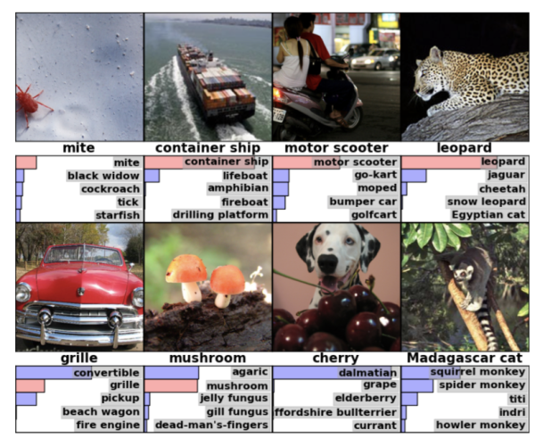
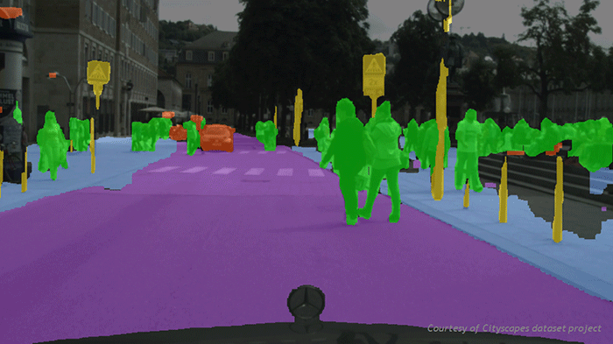

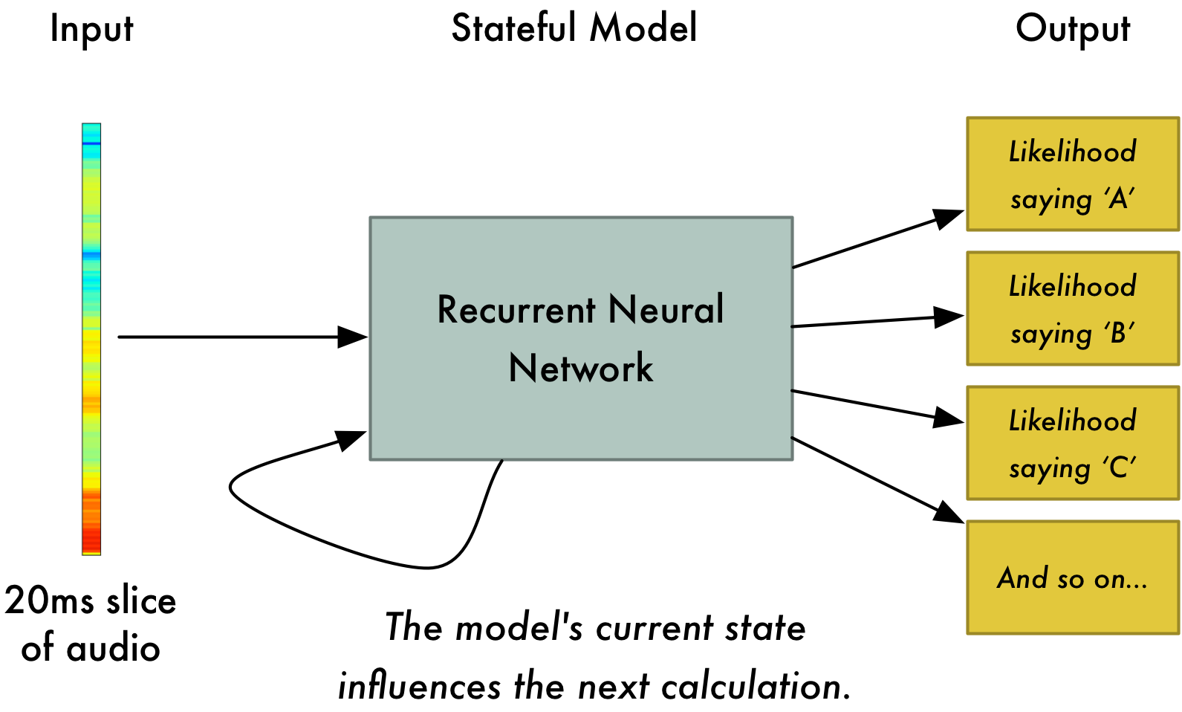
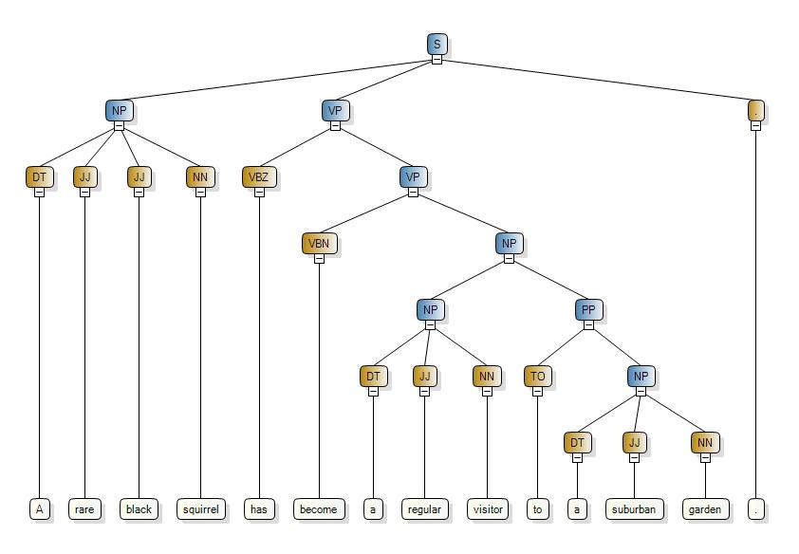
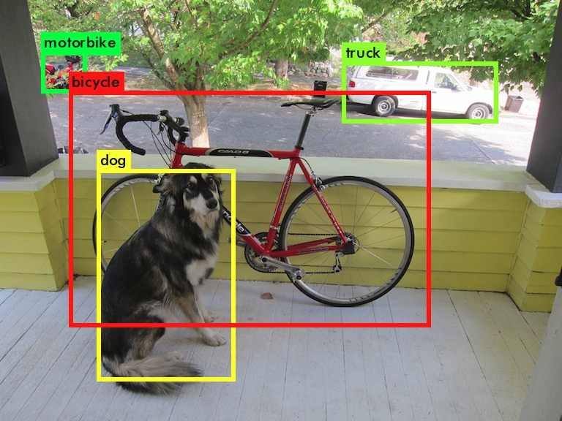
Rise of Deep Learning
Classification
Localization
Speech Recognition
Language Processing
Malware Detection
Autonomous Car

Slide 6
Let’s utilize DNNs for detecting anomalies in network systems

Slide 7
Flow-based
Builds high-level features for a whole flow
Total number of packets
Flow duration
Std of packet lengths
Total number of SYN,ACK, etc. flags
Ensemble of Autoencoders
Kitsune [Mirsky et al. ’18]
Energy in the GMM framework
DAGMM [Zong et al. ’18]
GAN
BiGAN-based [Zenati et al. ‘18]
Still at the research level!
Malicious
Feature Extractor
Anomaly Detector
Score
…
Stream of Packets
Threshold
Benign
Packet-based
Extracts features from each packet
Raw values from packet headers
IP header length
Hand-engineered features calculated based on a few packets
Train time
only receives benign traffic
Inference time
measures deviation from benign traffic

Slide 8
Adversarial Examples
Challenges
Data Labeling

Slide 9
Our goal is to build a better ML-based NIDS by addressing these two challenges

Slide 10
Defending against Adversarial Examples
Addressing Challenge 1

Slide 11
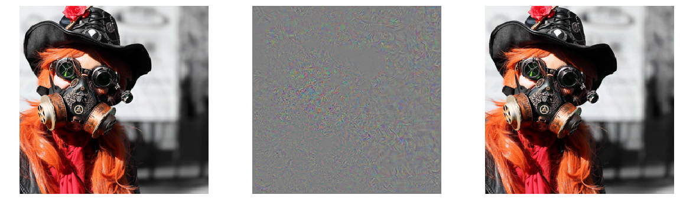
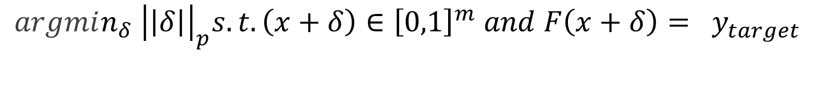
Neural networks are vulnerable to adversarial examples
$$argmin_{δ} {\left|\left|δ\right|\right|}_{p}s.t. \left(x+δ\right)∈{\left[0,1\right]}^{m} and F\left(x+δ\right)= y_{target}$$
Gas mask
Difference magnified by 10x
French bulldog
Existing NIDS have not been evaluated in an adversarial setting!

Slide 12
Limitation of Existing Adversarial Example Attacks In Evaluation of NIDS
Can’t directly use methods designed to craft adversarial examples against image classifiers to evaluate NIDS in an adversarial setting.
Network traffic and images have some intrinsic differences.
Pixel values can be freely modified in an image.
Changing some of the features extracted from the network traffic can break down the communication.
Need a new approach!

Slide 13
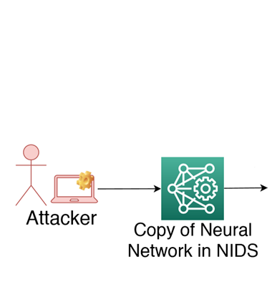
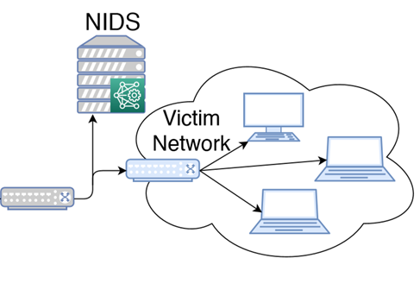
Threat Model
1
3
2
The attacker looks for general modifications applicable to all network attacks.
The attacker doesn’t want to change the individual network attack tools!

Slide 14
Adversarial Examples against NIDS
Transformations
Existing NIDS are vulnerable to adversarial examples!
Our attack can reduce the detection rate of different network attacks by up to 70%.
Changing the delay between packets
Fool the NIDS
Splitting a packet
Carry out original malicious intent
Injecting fake packets
Without breaking underlying network protocols
[Hashemi et al. ’19]

Slide 15
We need an NIDS which is more robust against the adversarial example attack.

Slide 16
Problems with Existing NIDS
Feature Extractor
Anomaly Detector

Slide 17
Extracted Features Are Designed to Detect Specific Types of Attacks
Features extracted by the existing feature extractors are designed in a way to detect streams in which lots of packets are sent in a short amount of time.
Hand-engineered features designed to detect specific types of attacks contradict our initial goal to detect zero-day attacks.

Slide 18
Reconstruction Based on Full Observation Leads to Over-Generalization
Anomaly
Ideal Anomaly Detector
Score(x)
Normal
0

Slide 19
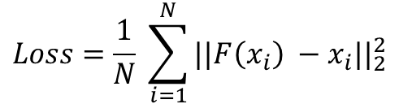
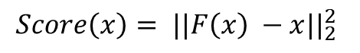
Reconstruction Based on Full Observation Leads to Over-Generalization
Reconstruction of the input based on full observation is too easy!
Model can reconstruct anomalies as good as normal inputs!
x
F
F(x)
$$Loss=\frac{1}{N} \sum_{i=1}^{N}{{||F\left(x_{i}\right) −x_{i}||}_{2}^{2}}$$
0
$${Score\left(x\right)= ||F\left(x\right) −x||}_{2}^{2}$$

Slide 20
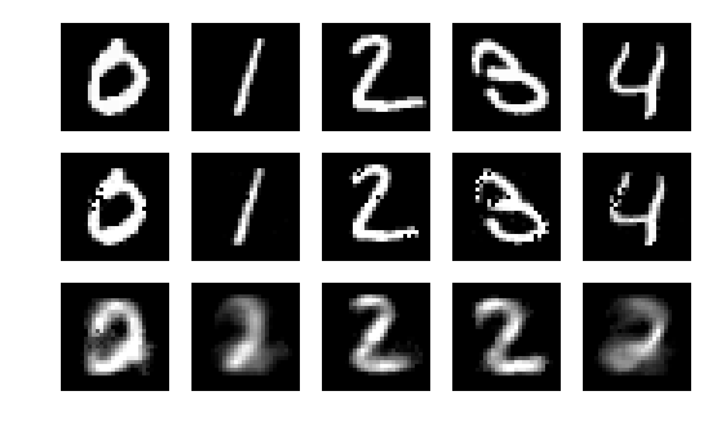
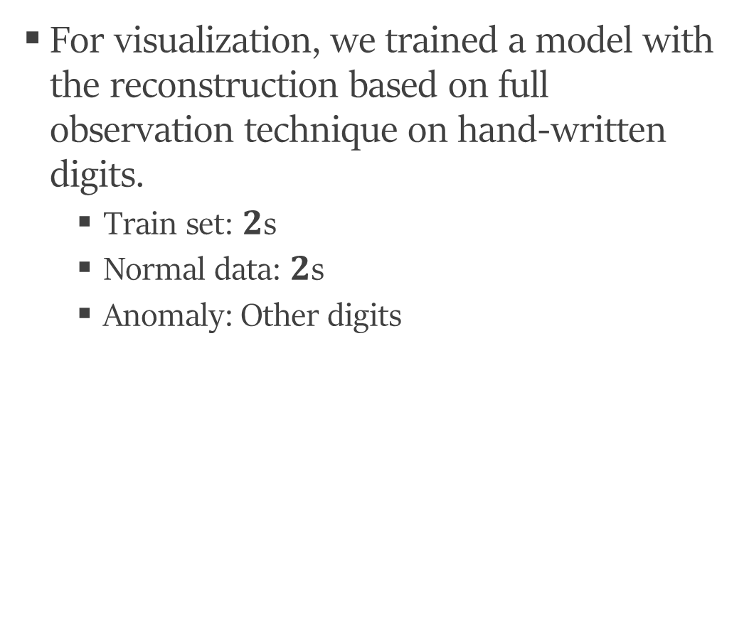
Reconstruction Based on Full Observation - Visualization
For visualization, we trained a model with the reconstruction based on full observation technique on hand-written digits.
Train set: $2$s
Normal data: $2$s
Anomaly: Other digits

Slide 21
PROPOSED SOLUTION

Slide 22
Feature Extractor
580
A packet-based feature extractor based on raw values extracted from each packet.
20
A
X
A
A
X
A
X
Will be fed to the anomaly detector
…
…
X
A
X
X
A
X
A
AX__XA
A
X
B
B
X
Y
B
Inter-arrival time
From Ethernet header
Frame length
From IP header
IP header length, IPlength, IP flags (df, mf, rb), TTL
From TCP header:
source port, destination port, sequence number, acknowledgment number, TCP flags (res, ack, cwr, ecn, fin, ns, push, reset, syn, urg), TCP window size, urgent pointer
Direction
29 features for each packet
Group by
src. & trg. IPs
…
…
X
A
Y
Y
A
B
Y
Stream of Packets
B
B
Y
B
Y
Y
B
…
Y
Y
B
Y
B
B
Y
BY__YB

Slide 23
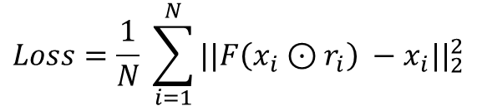
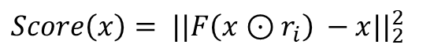
Reconstruction from Partial Observation (RePO)
A harder problem!
The model should generate the hidden parts based on what it observes.
x
F
F(x)
$$Loss=\frac{1}{N} \sum_{i=1}^{N}{{||F\left(x_{i}⊙r_{i}\right) −x_{i}||}_{2}^{2}}$$
010010…….0111011
110100…….1100010
0
$${Score\left(x\right)= ||F\left(x⊙r_{i}\right) −x||}_{2}^{2}$$

Slide 24
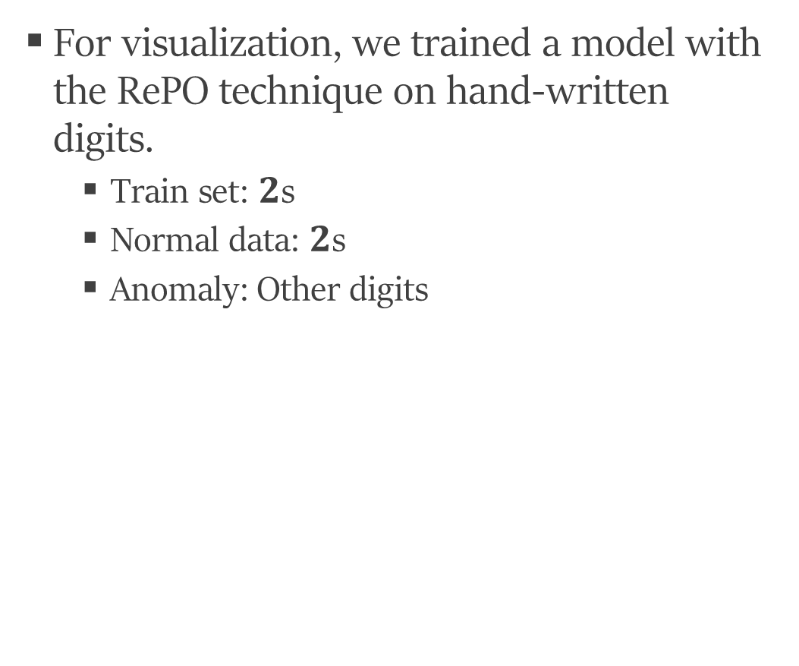
RePO - Visualization
For visualization, we trained a model with the RePO technique on hand-written digits.
Train set: $2$s
Normal data: $2$s
Anomaly: Other digits
Input
Full observation
RePO

Slide 25
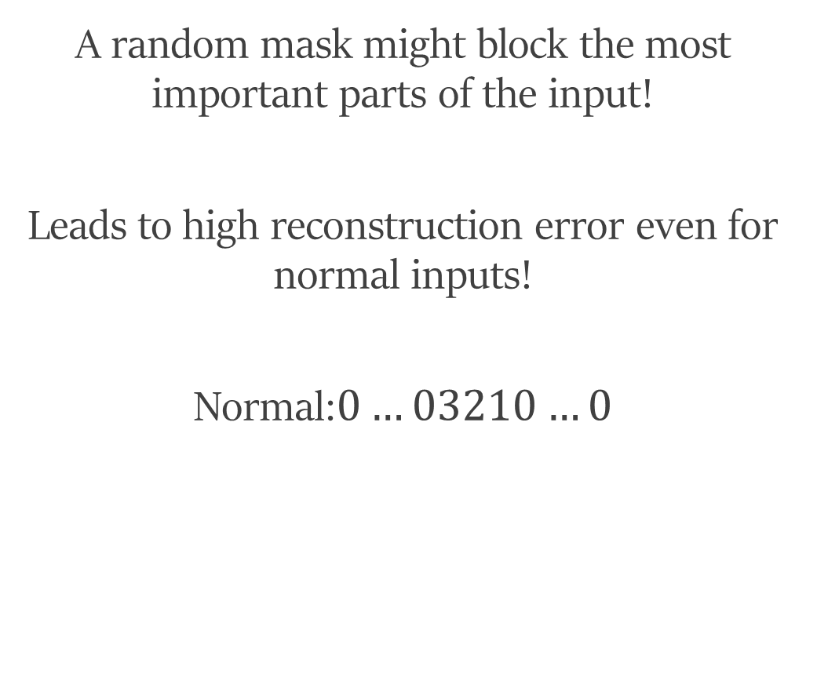
Effect of Bad Masks
A random mask might block the most important parts of the input!
Leads to high reconstruction error even for normal inputs!
Normal:$0…03210…0$
0,3,2,1,0,0,0,0
?,?,?,?,?,?,?,?
0,3,2,1,0,0,0,0
Bad Mask
F
x
F(x)

Slide 26
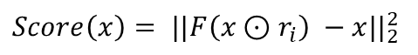
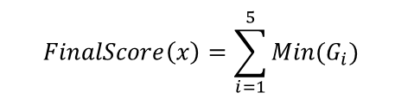
RePO+
Better distinguishment between normal and anomaly inputs
…
…
N
N
Higher detection rate!
$${Score\left(x\right)= ||F\left(x⊙r_{i}\right) −x||}_{2}^{2}$$
…
1.7
0.5
0.9
…
3.1
0.1
2.5
3.6
…
0.4
$$FinalScore\left(x\right)=\sum_{i=1}^{5}{Min(G_{i})}$$
5
2.1
1.1
0.7
…
2.4
0.9
1.5
2.5
…
0.5
5.3
3.3
1.3
1.6
Bad Mask!
N/5

Slide 27
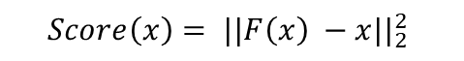
RePO+ Is More Robust Against Adversarial Examples
$${Score\left(x\right)= ||F\left(x\right) −x||}_{2}^{2}$$
Benign
Malicious

Slide 28
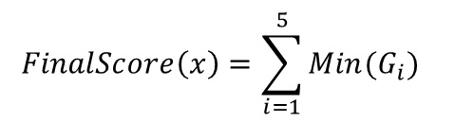
RePO+ Is More Robust Against Adversarial Examples
The adversary should plan to modify a larger set of features to fool the model.
…
…
Such changes might not be feasible!
N
N
$$FinalScore\left(x\right)=\sum_{i=1}^{5}{Min(G_{i})}$$
The model becomes more robust against the adversarial example attack!
Benign
Malicious

Slide 29
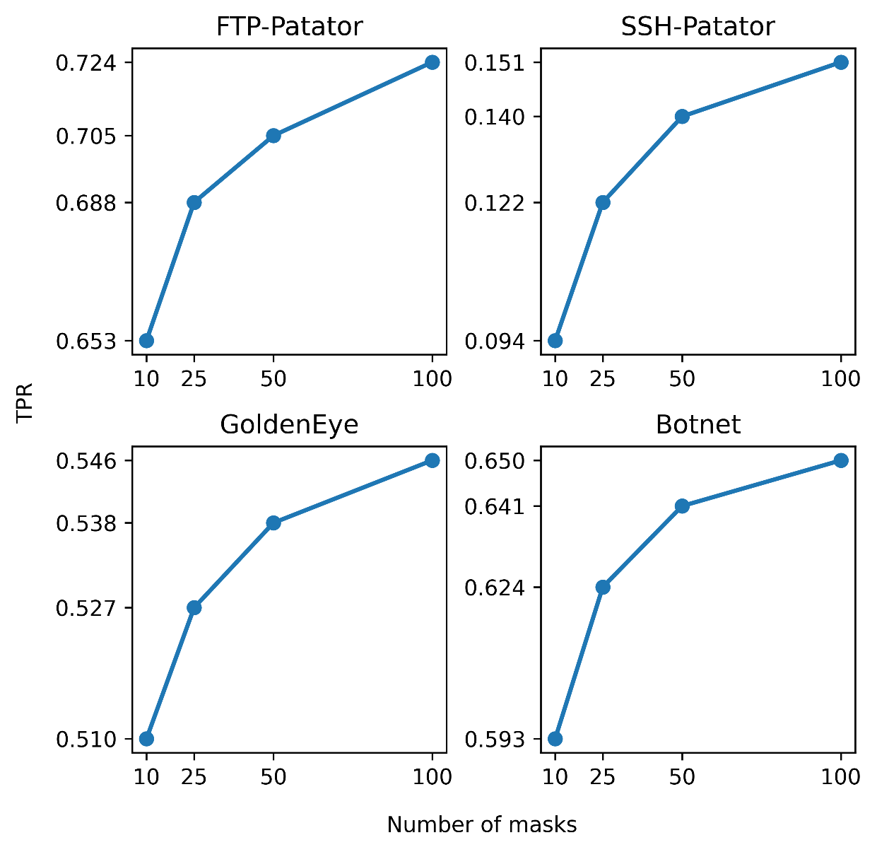
Choosing The Number of Random Masks
More random masks
More robustness against Adv. Ex.

Slide 30
EVALUATION

Slide 31

Packet-based NIDS in an Adversarial Setting
Total number of attacks detected
Kitsune
5
Average detection rate across all attacks
Kitsune
16.62%
Average drop in detection rate
Kitsune
26.74%
$$TPR=\frac{TP}{P}=\frac{TP}{TP+FN}=1 −FNR$$

Slide 32
Packet-based NIDS in an Adversarial Setting
Total number of attacks detected
Kitsune
RePO+
5
10
Average detection rate across all attacks
Kitsune
RePO+
16.62%
62.07%
3.7x better
Average drop in detection rate
Kitsune
RePO+
26.74%
2.36%
11.3x better
$$TPR=\frac{TP}{P}=\frac{TP}{TP+FN}=1 −FNR$$

Slide 33
Contributions
Designed a new method to evaluate ML-based NIDS in an adversarial setting.
Utilized the RePO+ technique to build a new NIDS to increase the robustness against adversarial examples.
Evaluated our NIDS on a dataset consisting of 11 different network attacks and could increase the average detection rate by up to 45% in an adversarial setting.

Slide 34
Solving Data Labeling Issue by Utilizing Domain Adaptation
Addressing Challenge 2

Slide 35
Labeling Network Traffic Is Challenging
Labeling a huge dataset consisting of billions of packets is challenging.
Expensive
Time-consuming
Not practical for zero-day attacks!
Ultimate goal of building an ML-based NIDS is to detect unseen attacks.
Can’t label them in advance to train a model on.
Existing ML-based NIDS
Have been trained in an unsupervised manner,
Only on benign traffic
Generate so many false alerts while detecting different network attacks.
Neural networks work the best when trained in a supervised fashion on lots of labeled data.

Slide 36
How can we benefit from limited data labeling to build a more accurate NIDS?

Slide 37
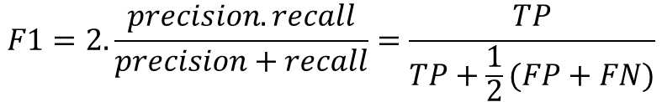
Proposed Idea
Instead of labeling all the network traffic which
Is expensive
Is time-consuming
Suffers from the problem of zero-day attacks
We want to label a small portion of network traffic
That includes some of the known attacks
Be able to detect most types of attacks including unseen attacks in the future
without a need to directly label them
A vanilla supervised learning method doesn’t work in this scenario!
Source/Labeled
Target/Unlabeled
Slowloris, Slowhttptest, Hulk
SSH-Patator, FTP-Patator
F1 on target: 0.03
$$F1=2. \frac{precision.recall}{precision+recall}=\frac{TP}{TP+\frac{1}{2}(FP+FN)}$$

Slide 38
Why Doesn’t a Vanilla Supervised Learning Method Work?
Domain Gap
High classification error

Slide 39
Domain Adaptation
Domain adaptation is the process of mitigating the domain gap
Between a labeled source dataset and an unlabeled target dataset
To transfer the knowledge gained form the source dataset to the target dataset
To minimize the classification error on the target dataset

Slide 40
Existing Domain Adaptation Methods
Self-Ensembling
CAN
[French et al. ICLR `18]
[Kang et al. CVPR `19]
CyCADA
CDAN
[Hoffman et al. ICML `18]
[Long et al. Neurips `18]

Slide 41


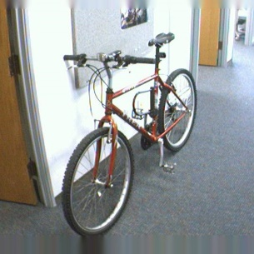
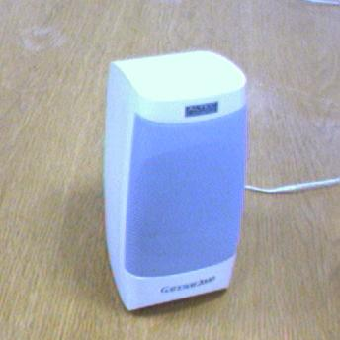
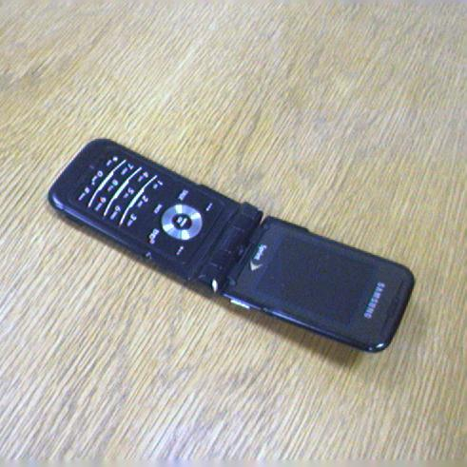
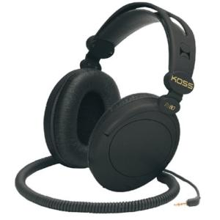
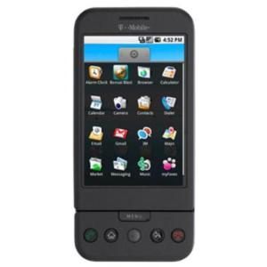
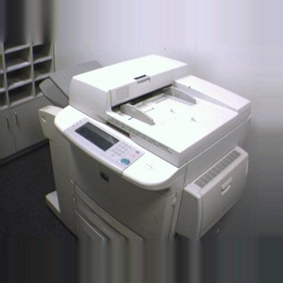
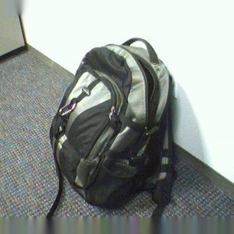
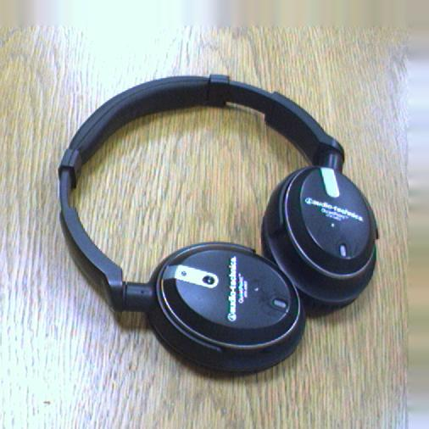

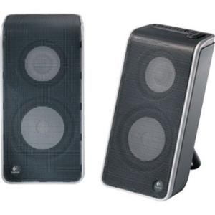
Existing work show promising results in image classification
79%
CAN
94%

Slide 42
First Attempt:
Let’s utilize an existing domain adaptation method to detect new network attacks.

Slide 43
Existing Work Can’t Be Used for This Scenario
Some of them are specifically designed for images since they reduce the domain gap at the pixel level.
CyCADA
Self-Ensembling
The others provide limited improvement when applied to other input types.
Source/Labeled
Target/Unlabeled
Slowloris SlowHTTPTest Hulk
SSH-Patator FTP-Patator
0.03
CAN
0.12

Slide 44
Problem With Existing work
They can’t generalize well across different input types.
Too complex and too many hyper-parameters
For using CDAN we have to deal with the difficulties of training GANs
There is no easy way to find the best hyper-parameters
Due to the lack of labeled validation set
No guarantee to prevent wrong alignment of target samples
Target domain representations from one class can get aligned with another class!

Slide 45
We need a new domain adaptation method that generalizes better across different input types

Slide 46
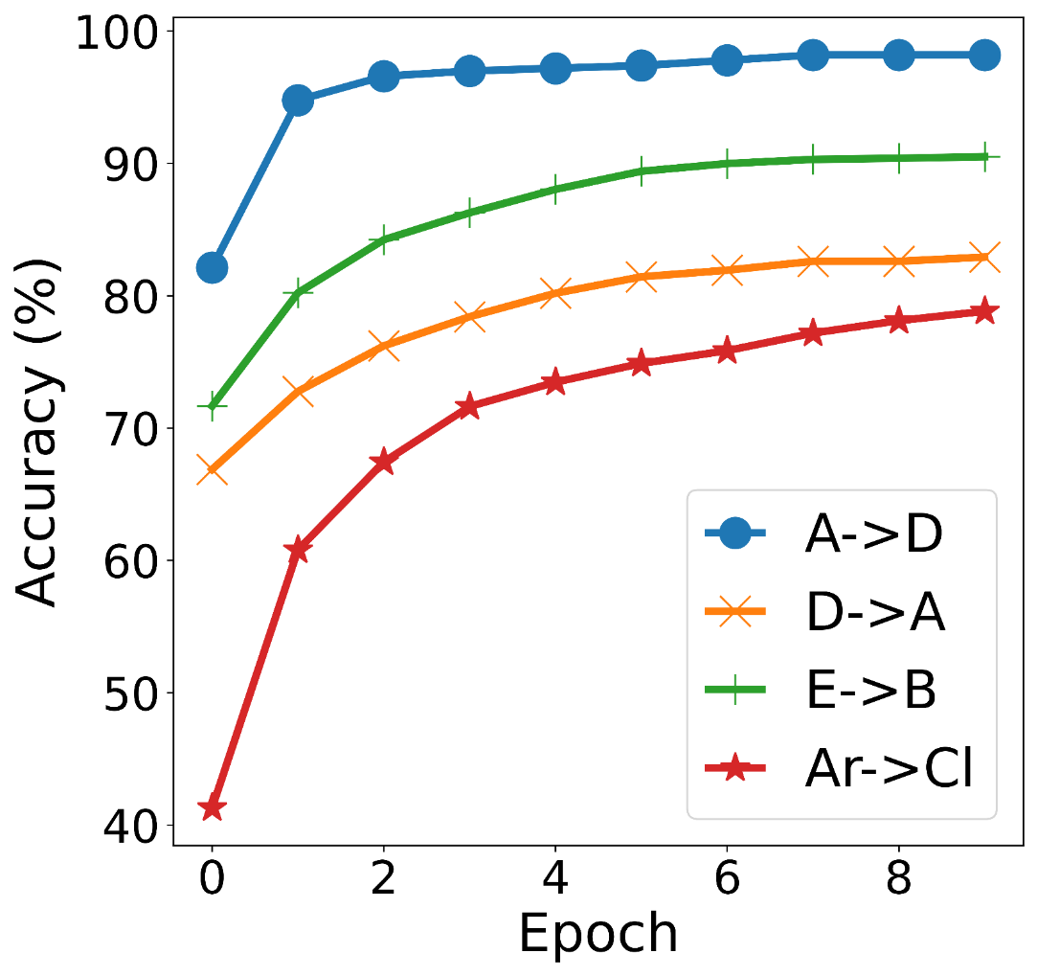
Insight 1 -Training only on correct samples gradually reduces the target error
Classified as 1!
Correct
Wrong
A
B
C
Correct
Wrong
Correct
Classified as 2!

Slide 47
Insight 2 – MSE is a better choice when training with pseudo-labels
Cross Entropy
Mean Square Error
No one-to-one mapping between the outputs of the Softmax layer and the logits!
✓
Target sample with pseudo-label C
Target sample with pseudo-label C
Mitigates the domain gap between the source and the target samples at logit space!
Source sample with label C
Source sample with label C
Logit space
Probability space
Logit space

Slide 48
Proposed Solution
?
Assign pseudo-labels to the target domain samples
Can’t tell which samples are wrong with 100% confidence!
Exclude wrong samples
Gradually reduce the target error!
Don’t know target domain labels!
Train on correct samples with MSE loss

Slide 49
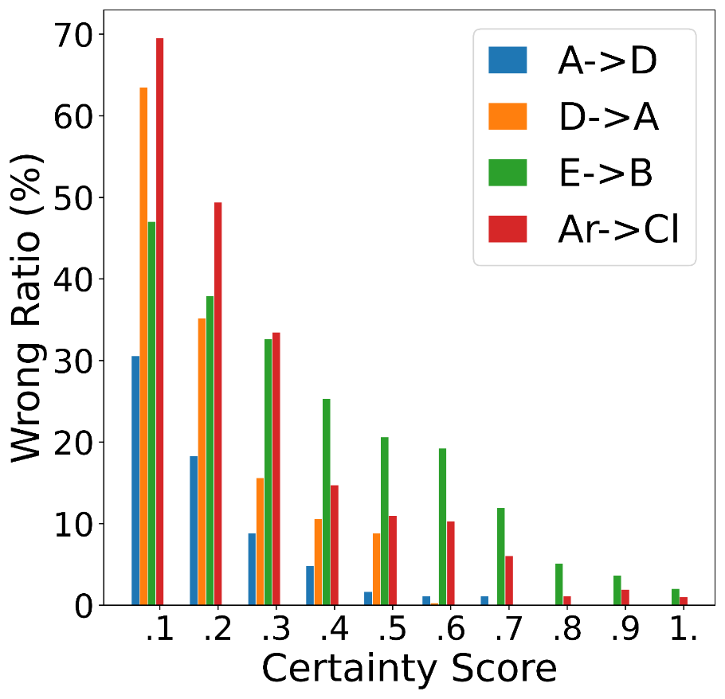
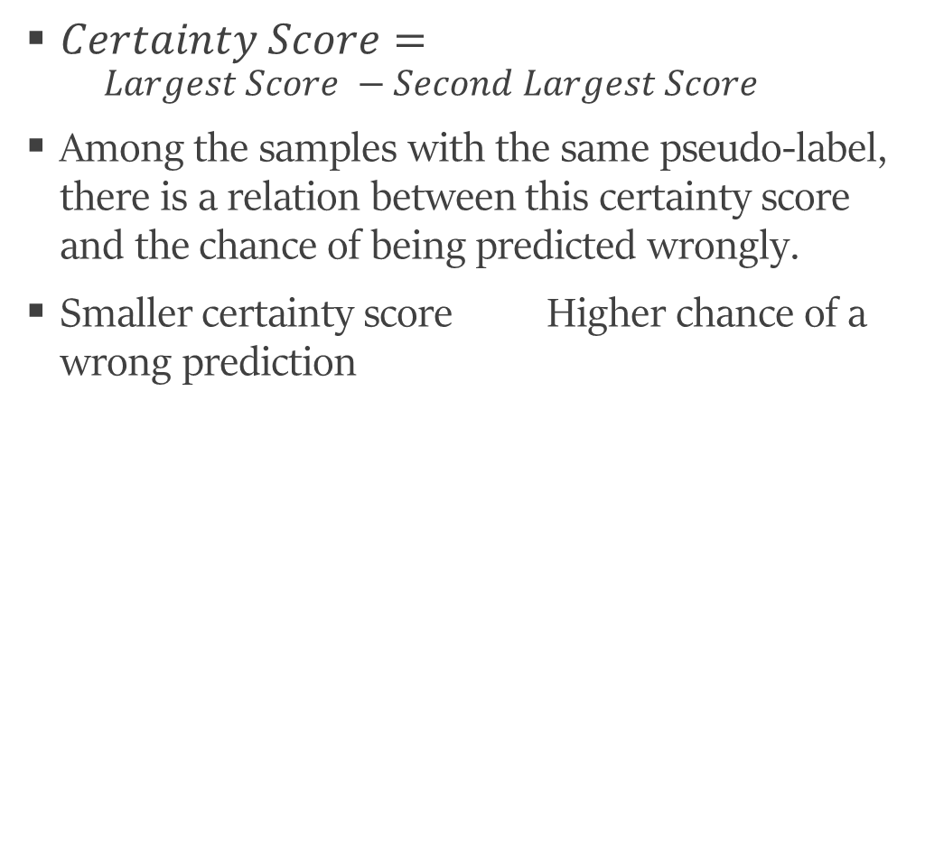
Insight 3 – an uncertainty metric can guide which predictions are wrong
$Certainty Score=$
$$Largest Score −Second Largest Score$$
Among the samples with the same pseudo-label, there is a relation between this certainty score and the chance of being predicted wrongly.
Smaller certainty score Higher chance of a wrong prediction

Slide 50
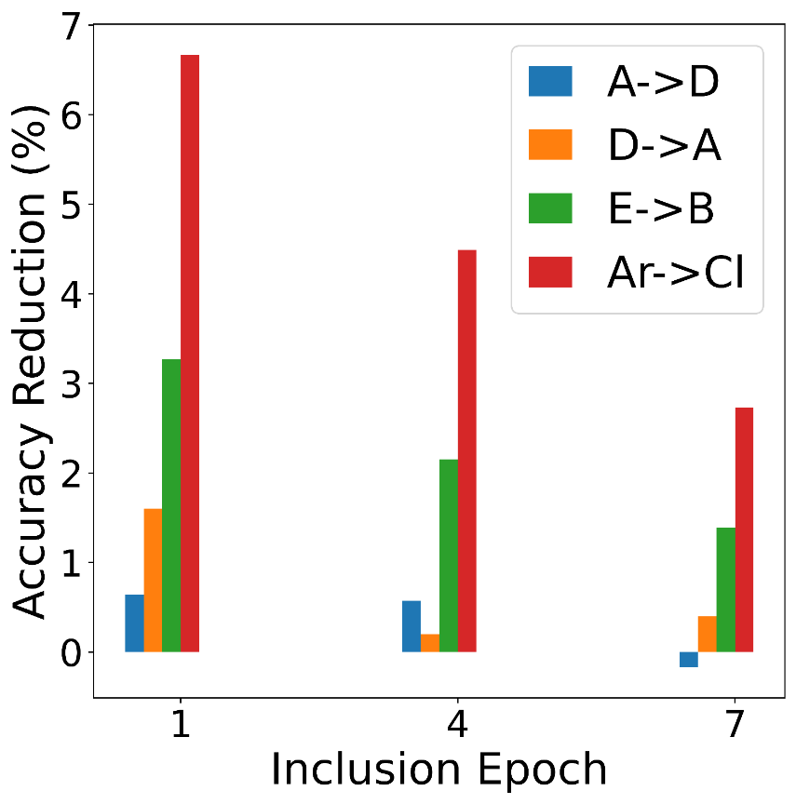
Insight 4 – the timing of inclusion of a wrong-prediction matters
Early inclusion of wrong samples into the training procedure deteriorates the model's performance on the target domain more than later inclusion.
Because of the same propagation phenomenon, we explained for insight 1.
7% reduction in final accuracy when the wrong samples were included in the first epoch compared to when they were included in the last epoch.
Trained each model for 10 epochs.

Slide 51
Proportional Progressive Pseudo Labeling
Train the model on the source domain.
Target domain samples
In each iteration of PPPL:
Feed all the target domain samples to the model.
Assign a pseudo-label to each of them based on the largest score the model outputs.
Group target domain samples based on their pseudo-labels, calculate the certainty score for each sample.
Model
exclude wrong predictions, or delay training on such samples or reduce their impact on the model parameters.
Less certain
More certain
…

Slide 52
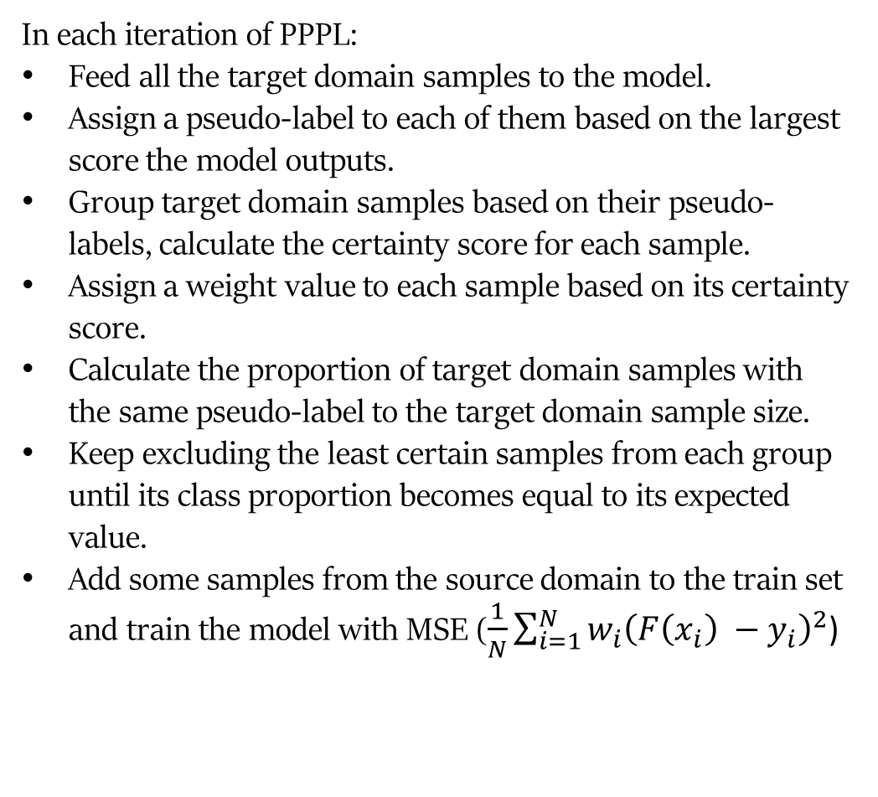
Proportional Progressive Pseudo Labeling
Train the model on the source domain.
Target domain samples
In each iteration of PPPL:
Feed all the target domain samples to the model.
Assign a pseudo-label to each of them based on the largest score the model outputs.
Group target domain samples based on their pseudo-labels, calculate the certainty score for each sample.
Assign a weight value to each sample based on its certainty score.
Calculate the proportion of target domain samples with the same pseudo-label to the target domain sample size.
Keep excluding the least certain samples from each group until its class proportion becomes equal to its expected value.
Add some samples from the source domain to the train set and train the model with MSE ($\frac{1}{N}\sum_{i=1}^{N}{w_{i}{\left(F\left(x_{i}\right) −y_{i}\right)}^{2}}$)
Model
exclude wrong predictions, or delay training on such samples or reduce their impact on the model parameters.
Less certain
More certain
…
W
0
[0.2 – 1]
We assume we know the target domain class proportions

Slide 53
EVALUATION

Slide 54
Dataset
We built 3 different subsets from the CICIDS-2017 dataset, each with different types of network attacks.
Domain A
FTP-Patator, SSH-Patator
Domain B
Slowloris, Slowhttptest, Hulk, GoldenEye, Heartbleed
Domain C
Web attacks, Infiltration
Defined 6 domain adaptation tasks between each pair of these domains.
e.g. A B, A C, …

Slide 55
Scenario 1 – Accurate Knowledge About Target Class Proportions
58% improvement

Slide 56
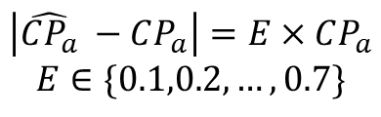
Scenario 2 – Inaccurate Knowledge About Target Class Proportions
$$\left|\hat{CP_{a}} −CP_{a}\right|=E×CP_{a}$$
$$E∈\{0.1,0.2, …, 0.7\}$$

Slide 57
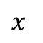
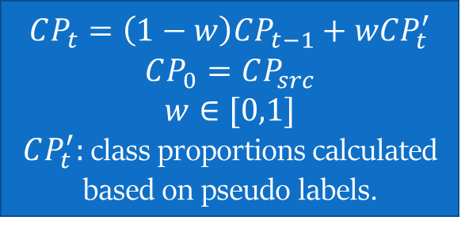
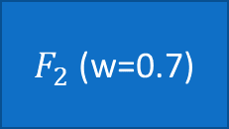
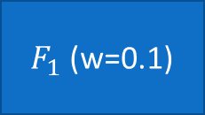
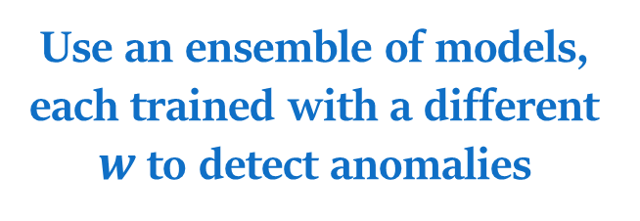
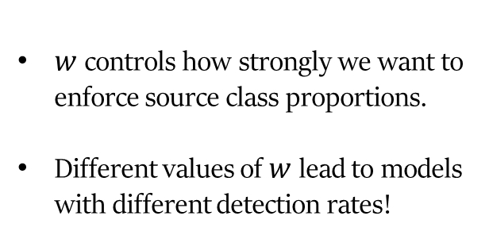
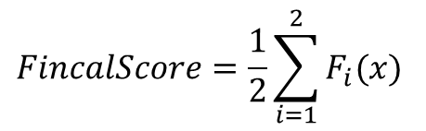
Scenario 3 – No Knowledge About Target Class proportions
Instead of fixed class proportions we run PPPL by enforcing adaptive class proportions as follows:
Use an ensemble of models, each trained with a different $w$ to detect anomalies
$$CP_{t}=\left(1−w\right)CP_{t−1}+wCP_{t}^{′}$$
$$CP_{0}=CP_{src}$$
$$w∈[0,1]$$
$CP_{t}^{′}:$class proportions calculated based on pseudo labels.
$$x$$
$F_{1}$ (w=0.1)
$F_{2}$ (w=0.7)
$w$ controls how strongly we want to enforce source class proportions.
Different values of $w$ lead to models with different detection rates!
$$FincalScore=\frac{1}{2}\sum_{i=1}^{2}{F_{i}(x)}$$

Slide 58
Scenario 3 Results – Ensemble of Models
47% improvement

Slide 59
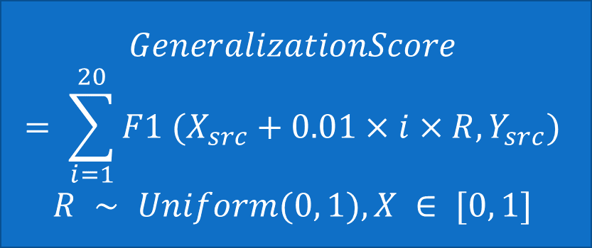
Scenario 3 – Second Approach
Depending on the situation, one model in the ensemble might detect anomalies better than the other.
Can’t confidently say which one detects target anomalies better.
Target domain labels are not available.
We can use the source domain to guess which model detects anomalies better in the target domain!
select the model that generalizes better in detecting anomalies in noisy versions of the source domain.
$$GeneralizationScore= \sum_{i=1}^{20}{F1 (X_{src}+0.01×i×R, Y_{src})}$$
$$R ∼ Uniform(0, 1), X ∈ [0, 1]$$

Slide 60
Scenario 3 Results – Model Selection
51% improvement

Slide 61
Generalization of PPPL on Other Input Types
Text
Image
5% improvement

Slide 62
Contributions
Designed PPPL which is a domain adaptation method that generalizes better than other methods across different input types.
Utilized PPPL to address the limitation of vanilla supervised learning methods in detecting unseen anomalies in network traffic.
Could build a more accurate ML-based NIDS and improved the detection rate of unseen anomalies by up to 58% compared to state-of-the-arts methods.

Slide 63
Publications
Towards evaluation of NIDSs in adversarial setting
BigDAMA 2019
Enhancing robustness against adversarial examples in network intrusion detection systems
IEEE NFV-SDN 2020
General Domain Adaptation Through Proportional Progressive Pseudo Labeling
IEEE BigData 2020

Slide 64
Questions?

